Slide 1
IGGI Game Design Part II AI Informed Game Design
Simon Lucas and Diego Perez

Slide 2
AI Informed Game Design
How can AI be used to make better games?
What does better mean?
Set design objectives in terms of player experience or game activity and results
Then try to meet them
Measure activity of a range of AI bots
What aspects of bot activity predict human experience?
Also run user trials
The course will be taught with a mixture of lectures, labs (including game AI competitions) and group work
Prepare for some challenging / interesting ideas!

Slide 3
Main Topics
Game Design Spaces
Design, Implementation and Testing
Game Activity and Player Performance
And how to measure it and form Objective Functions
Sample Efficient Noisy Optimisation
Important for Game Tuning
And AI Agent Tuning
We’ll use the N-Tuple Bandit Evolutionary Algorithm (NTBEA)
General Video Game AI and Video Game Description Language (VGDL)
General and easily applied AI Agent Algorithms via Statistical Forward Planning
Rolling Horizon Evolution
Monte Carlo Tree Search
Mini AI Competition

Slide 4
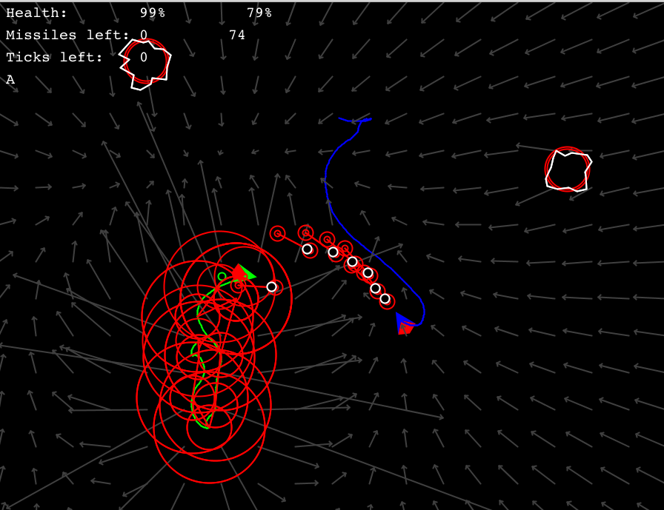
Example from 2015: “Battle Asteroids” (Thanks to IGGI Student: Memo Akten, Daniel Berio, Piers Williams, Joseph Walton-Rivers)
MCTS able to create reasonable agents for 2-player game
Sometimes with the silly assumptions about what the opponent will do!
Notes:
Example shows a mashup game taking Asteroids ships physics and rock-shooting, combined with snake or Tron style trail, and 2-player battle mode.

Slide 5
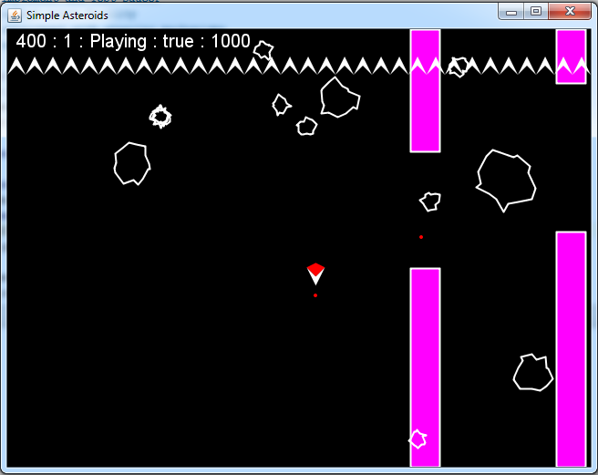
Game Mashup: Flappy Asteroids
Now have to pass through the pipes as well as surviving the Asteroid Shower!
Very bad news for Rotate-n-Shoot! (A simple strategy that works ok for Asteroids)
Notes:
The point here is that new rules are mechanics, or simply different tuning can make games that defeat simple repetitive strategies

Slide 6
Two-Faced Asteroids
One side explodes the Asteroid as normal
The other causes the missile to bounce straight back
Also very bad news for Rotate-n-Shoot!!

Slide 7
Automated Game Design
An exciting topic in Game AI and in Computational Creativity
Can an algorithm automatically design novel high quality games, or game levels?
Or perhaps choose good parameters for an existing game?
Work in this area has been around for a while
But with better general purpose AI, is really starting to take off now

Slide 8
Automated Game Design: Main Steps and Challenges
Main steps:
Creating a search space for a set of games (or game levels)
Creating operators to choose points in the space, and also variation operators to choose points in some neighbourhood (e.g. a Mutation operator)
Evaluate points in the search space
In general, the final step (evaluation) is the hardest!
For a restricted set of games, we can write evaluation heuristics
Or measure the experience of AI bots …

Slide 9
Using AI Bots for Play-Testing
Two challenges with the AI bots:
Providing bots which are smart enough (remember it’s easy to make a smart bot behave stupidly)
General Video Game AI (GVGAI) has already made good progress with this
But plenty more is possible
Interpreting the experience the bots have in a meaningful way.
Hard in general, but some notable successes
Discussion question: how would you deliberately impair the performance of a smart bot?
Give two reasons why you may wish to do this

Slide 10
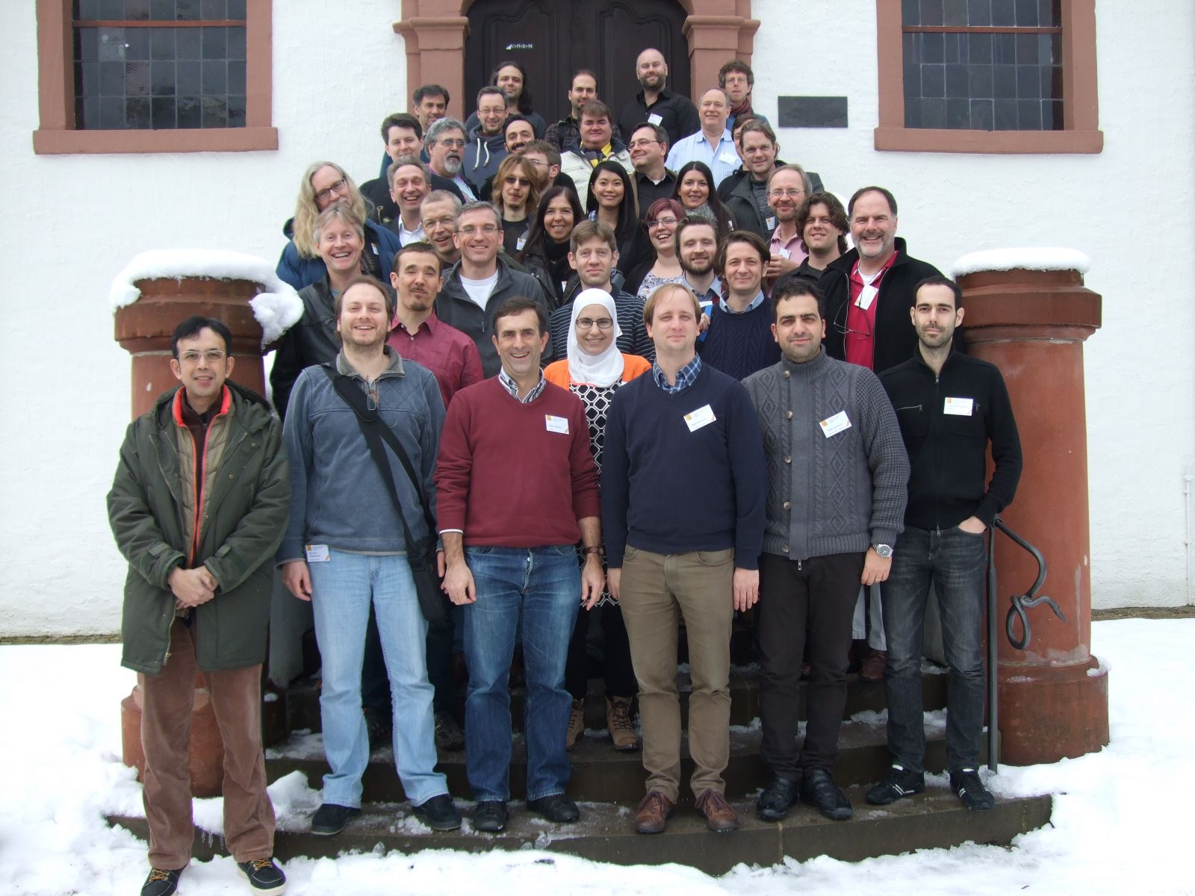
We’ll run it a bit like a Dagstuhl Seminar – Interesting challenges solved in groups

Slide 11
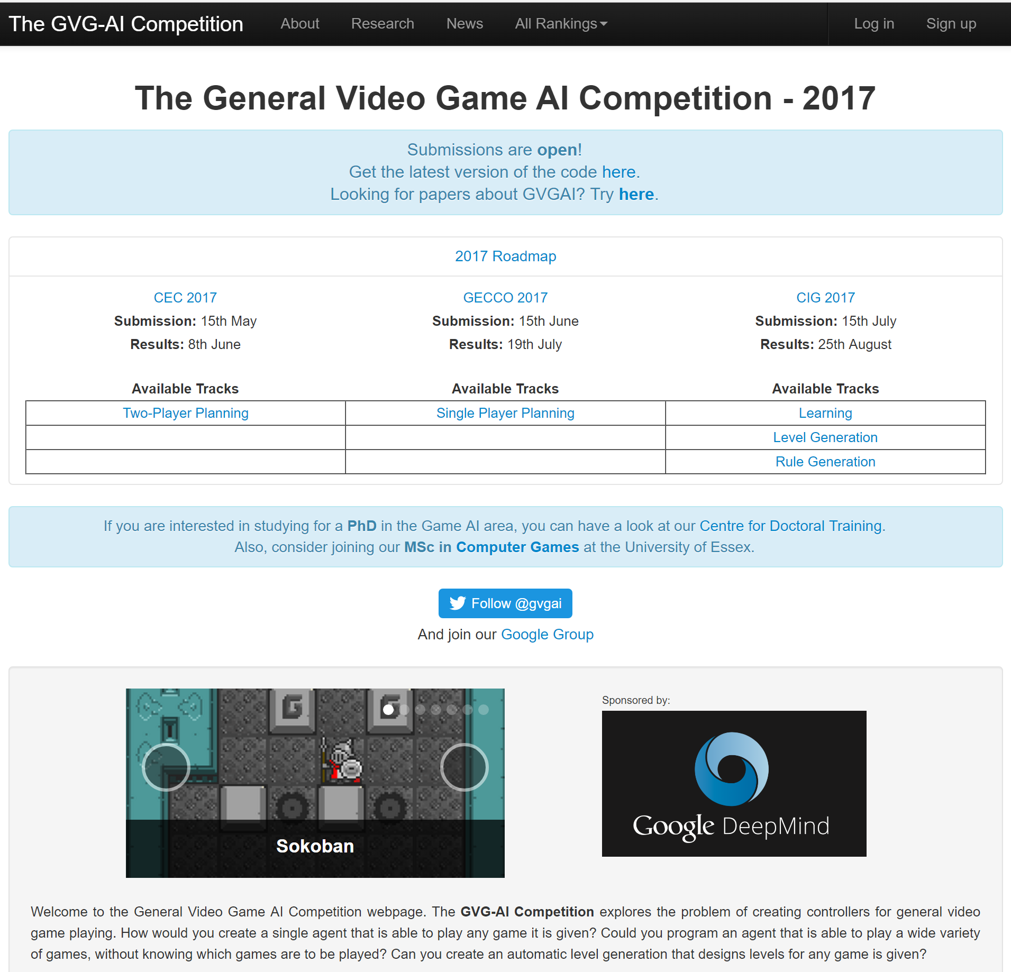
Can we find a sweet-spot search space between numerical parameter tuning and VGDL?

Slide 12
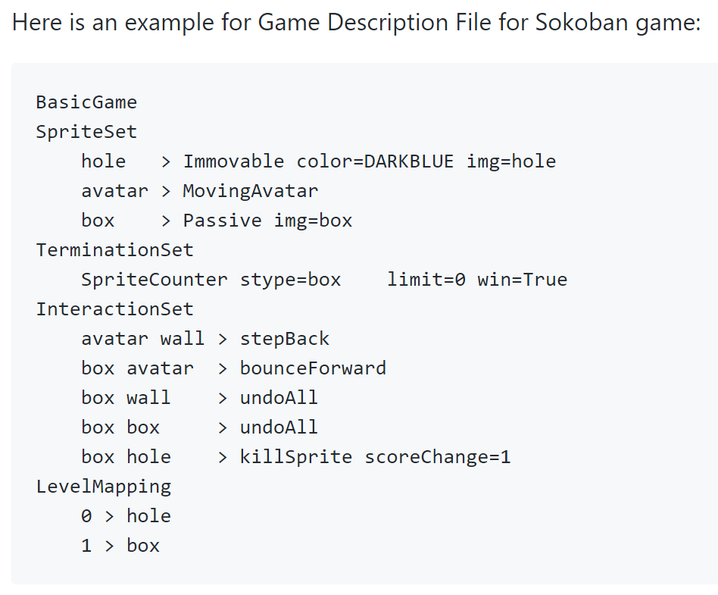
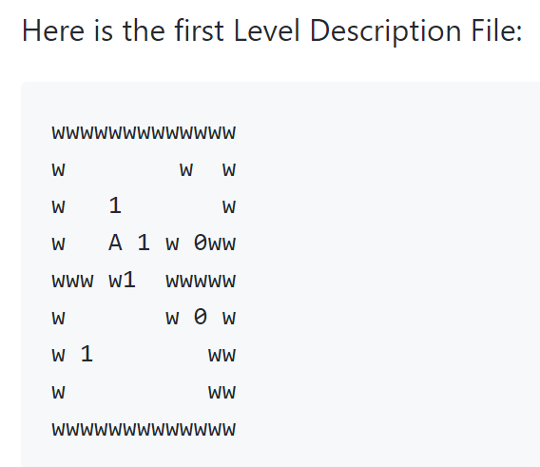
VGDL Example with Level Design https://github.com/EssexUniversityMCTS/gvgai/wiki/VGDL-Language

Slide 13
AI Agent Algorithms
Simulation-based (require a forward model, preferably a fast one!)
We call this statistical forward planning
Flat Monte Carlo (MC)
Monte Carlo Tree Search (MCTS)
Rolling Horizon Evolutionary Algorithms
Reactive (no forward model, or limited forward model)
Neural nets and other function approximators
Table-based
Trained through Evolution or Temporal Difference Learning
Results with Deep RL (e.g. VizDoom, AlphaGoZero)
These methods can also be very effectively hybridised for best performance

Slide 14
Simulation-based versus Learning Based AI
Simulation-based AI: (aka SFP)
Intelligence emerges by running lots of simulations
Can work with NO prior training
Though training can be used to improve performance
Instant intelligence, but can be CPU hungry
Learning-based AI
May be much faster than simulation-based AI once trained
BUT: may take a LONG time to train (hours, days or even longer)

Slide 15
What you need to implement:
public interface AbstractGameState { AbstractGameState copy(); AbstractGameState next(int[] actions); int nActions(); double getScore(); boolean isTerminal(); }
Notes:
Here’s what you need to do to add this magic AI to your game or system: the ones to be careful with are copy and next

Slide 16
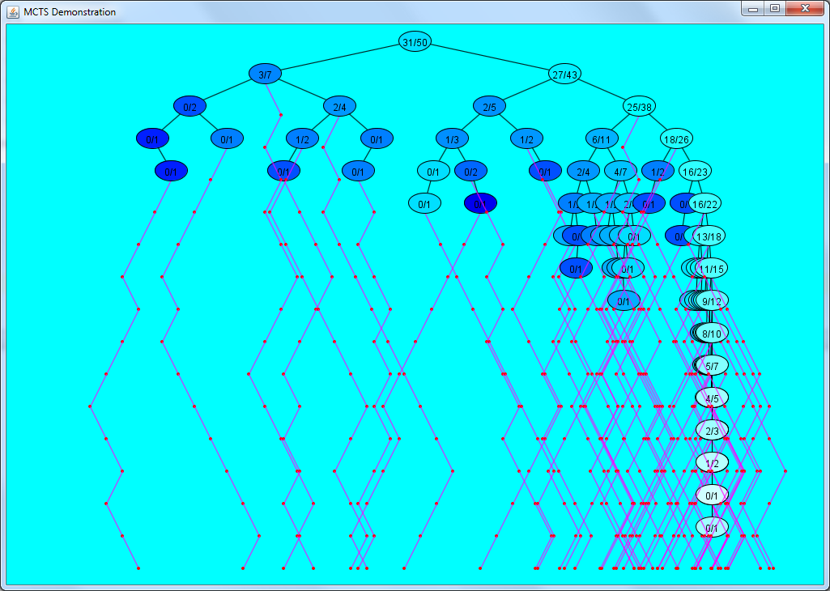
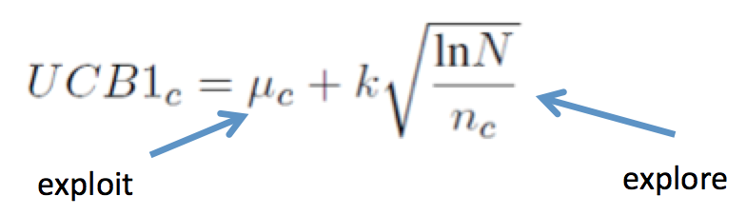
A Taste of Things to Come (MCTS)
Aims to balance exploration and exploitation
In video games the limited roll-out budget is a challenge, but not the only one!
Notes:
MCTS build asymmetric trees – balancing exploration and exploitation. Interestingly the exploration constant is often set to zero, with other heuristic terms being used to force exploration

Slide 17
Rolling Horizon Evolution

Slide 18
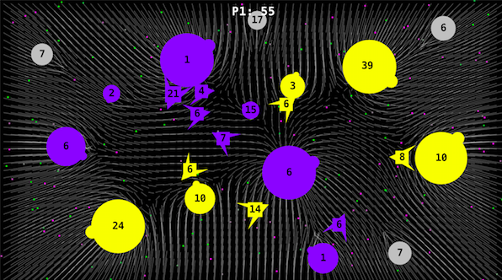
Copy state (20), copy-mutate seq(20), run (20 x 100), score (20), play, shift, repeat
93 [2, 17, 1, 11, 7, 5, 14, 8, 2, 12, 16, 1, 15, 7, 2, 3, 13, 2, 2, 10, 2, 12, 17, 2, 13, 11, 4, 13, 16, 13, 11, 17, 9, 7, 3, 9, 15, 7, 3, 11, 15, 10, 2, 11, 15, 4, 11, 15, 13, 13, 15, 13, 12, 9, 4, 17, 11, 4, 8, 16, 17, 0, 7, 17, 16, 7, 8, 16, 9, 16, 5, 14, 2, 5, 14, 16, 5, 14, 8, 6, 1, 14, 9, 13, 17, 13, 0, 17, 0, 2, 16, 6, 8, 16, 7, 7, 1, 2, 15, 5, 0, 0, 4, 10, 5, 8, 11, 3, 13, 15, 2, 13, 5, 9, 3, 0, 5, 15, 13, 3, 6, 15, 11, 12, 16, 10, 8, 12, 15, 17, 14, 2, 7, 5, 8, 2, 10, 5, 4, 13, 14, 1, 2, 1, 15, 4, 7, 3, 15, 15, 16, 3, 11, 12, 4, 11, 2, 17, 15, 9, 1, 0, 9, 15, 16, 8, 4, 12, 7, 16, 11, 6, 4, 8, 10, 4, 7, 17, 17, 9, 5, 10, 16, 11, 4, 8, 7, 1, 1, 13, 5, 4, 12, 15, 8, 13, 13, 13, 13, 13]
eval
copy
472 [2, 17, 1, 11, 7, 5, 14, 8, 2, 12, 15, 1, 15, 7, 2, 3, 13, 2, 2, 10, 2, 12, 17, 2, 13, 11, 4, 13, 16, 13, 11, 17, 9, 7, 3, 9, 15, 7, 3, 11, 15, 10, 2, 11, 15, 4, 11, 15, 13, 13, 15, 13, 12, 9, 4, 17, 11, 4, 8, 16, 17, 0, 7, 17, 16, 7, 8, 16, 9, 16, 5, 14, 2, 5, 14, 16, 5, 14, 8, 6, 15, 14, 9, 13, 17, 13, 0, 17, 0, 2, 16, 6, 8, 16, 7, 7, 1, 2, 15, 5, 0, 0, 4, 10, 5, 8, 11, 3, 13, 15, 2, 13, 5, 9, 3, 5, 5, 15, 13, 3, 6, 15, 11, 12, 16, 10, 3, 12, 15, 17, 14, 2, 7, 5, 8, 2, 10, 5, 4, 13, 14, 1, 2, 1, 15, 4, 7, 3, 15, 15, 16, 3, 11, 7, 4, 11, 2, 17, 15, 9, 1, 0, 9, 15, 16, 8, 4, 12, 7, 16, 11, 6, 4, 8, 10, 4, 7, 17, 17, 9, 5, 10, 16, 11, 4, 8, 7, 1, 1, 13, 5, 4, 12, 15, 8, 13, 13, 13, 13, 13]
eval
copy

Slide 19
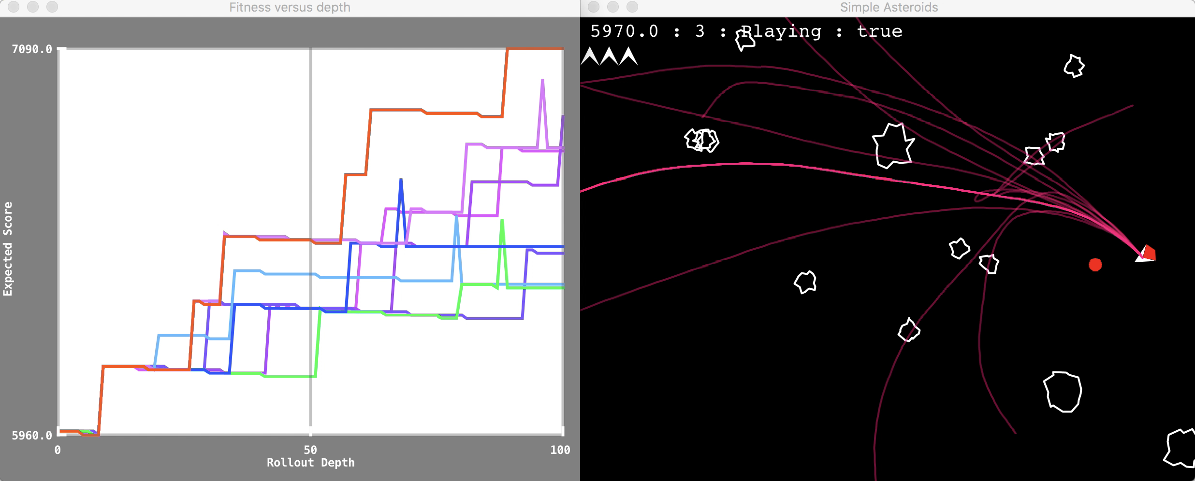
Rolling Horizon Evolution in Asteroids (each number corresponds to a joystick action)

Slide 20
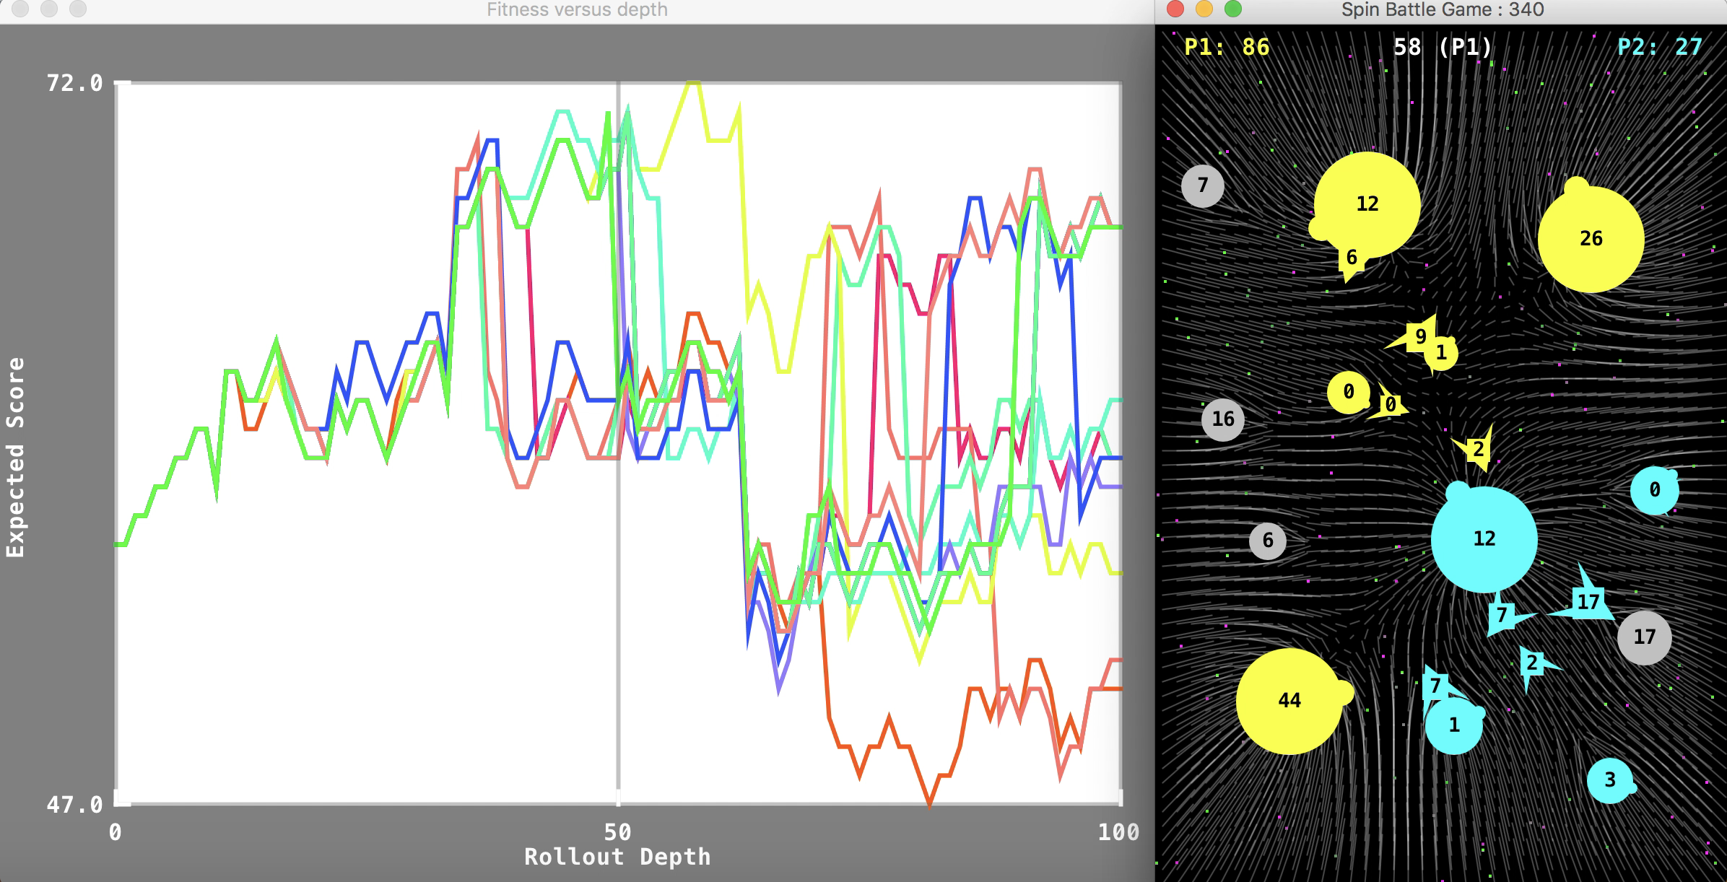
Rolling Horizon Evolution in Planet Wars (each number-pair specifies source and target planets for fleet transits)

Slide 21
Use in Game Design
Analyse performance of AI players
They adapt INSTANTLY to changes in the game
Trajectories of Game Objects
Notes:
Are curved trajectories more interesting for human players?

Slide 22
If 2,000 ticks is the answer
What was the question?
Notes:
This slide makes the point about the number of game ticks needed in order to optimise a game. How many are needed?

Slide 23
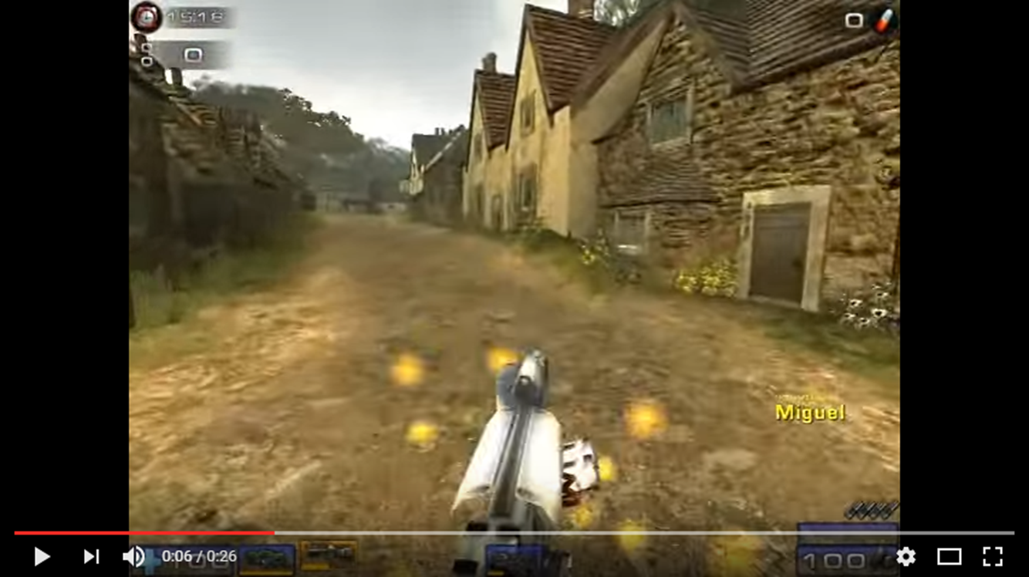
Applications of Adaptive Game AI
Instant high quality opponents and / or collaborators
No programming of the agent needed – just ensure that the game implements a standard interface
Can train them to be more human-like (e.g. Runarsson and Lucas, Devlin et al, 2k Bot Prize (unreal tournament)
Automated play testing of games
Can invent new games easily!
Picking the good ones is the trickier part…
Adaptive AI can help
Measure drama
Measure skill
Can “good” players beat random players
What is span of Elo ratings?
A large span is evidence that the game has skill depth

Slide 24
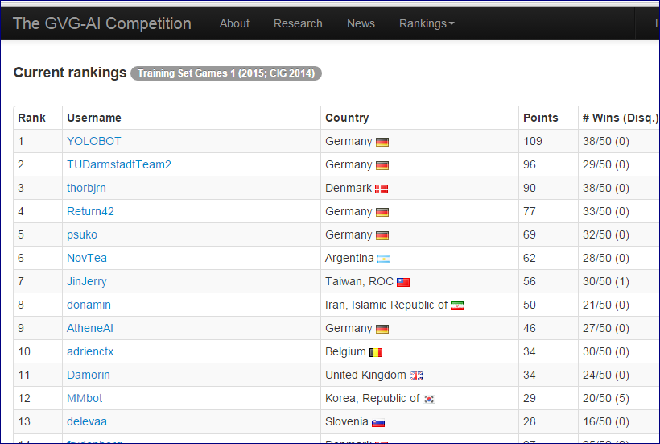
Should good games have a large span of game agent rankings?

Slide 25
Evaluating Games using AI Bots
But note that many aspects of a game can be measured using bots
For many of these it is not necessary that a bot mimics a human player
Though that would be ideal!
And keep in mind there is enormous variation in the set of human players
So what it means to be “human-like” is not precisely defined

Slide 26
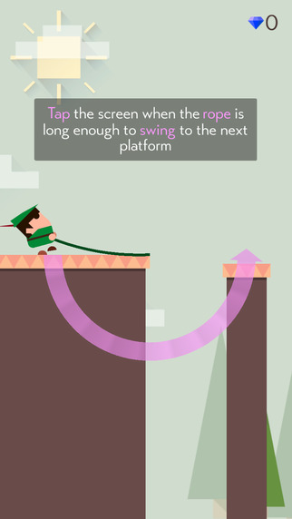
Tap-Based Casual Games
Flappy Bird Phenomenon
Since then some good one-touch games
Retry, Mr Jump, Swing

Slide 27
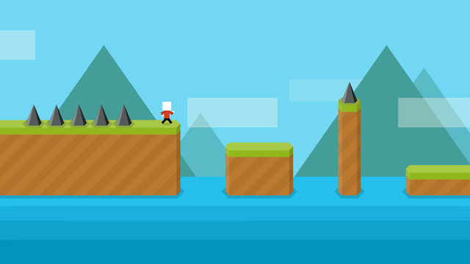
Mr Jump

Slide 28
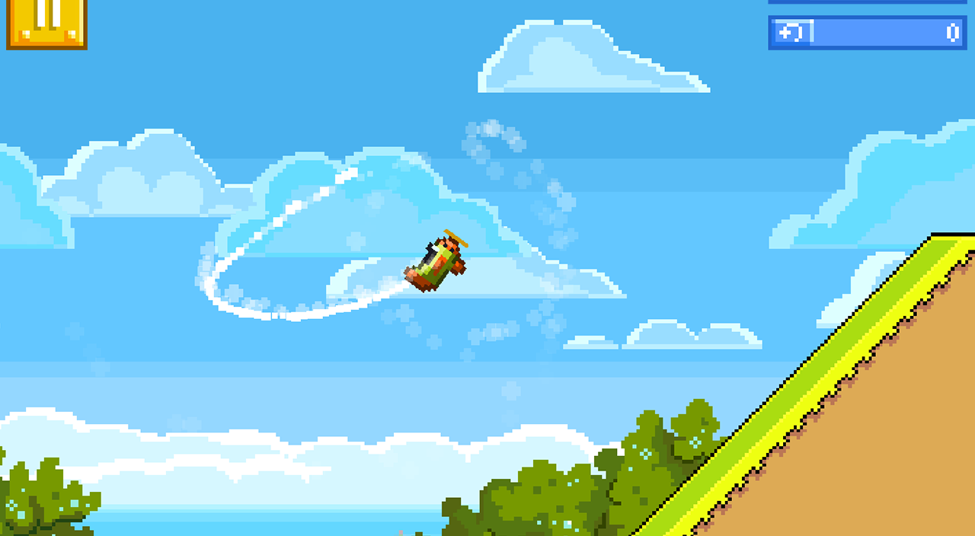
Retry

Slide 29
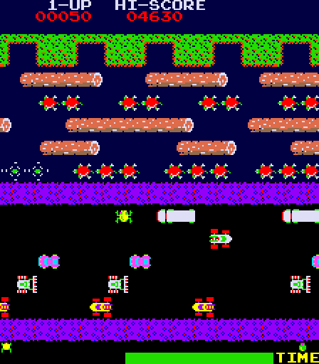
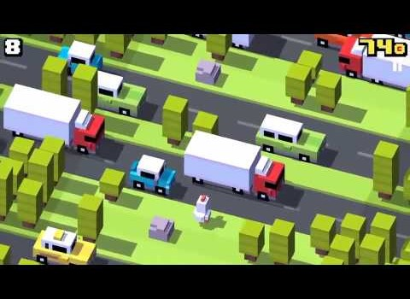
Plenty of “inspiration” out there…
Notes:
So many classic arcade games: interesting opportunities to breathe new life into them!

Slide 30
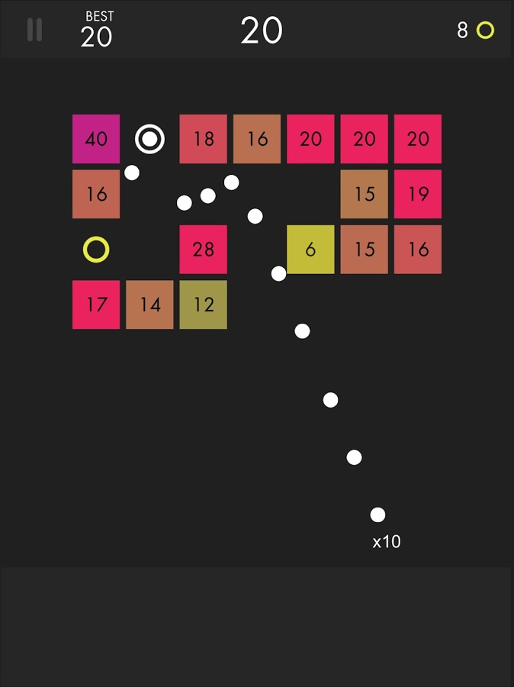
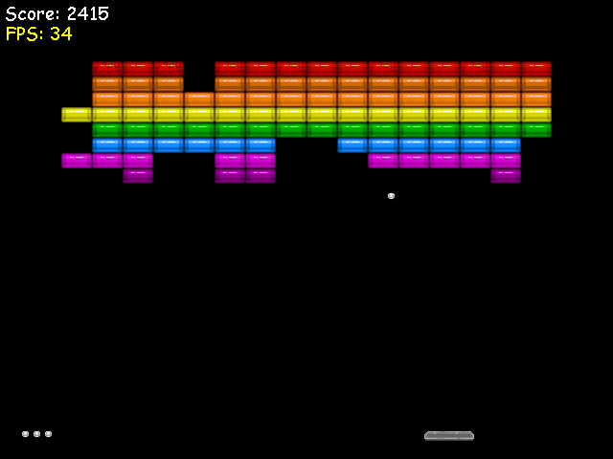
Breakout -> Ballz

Slide 31
Deliverables / Assessments
Report in the form of a short draft conference paper. The paper should include or be accompanied by a brief statement of the contribution of each author.
Peer-review comments on the paper (peer review is by course participants)
Code to support all experimental results in the paper
Code for Game AI Competition
A video showing the games in action
Data (game logs etc) underlying the results in the paper
We encourage groups to revise their papers after the peer feedback and submit to a relevant conference or workshop

Slide 32
Summary
There are great opportunities for mining variations in existing games
Or tuning the hell out of a game to ensure it plays as well as possible
We’ll study general AI methods for both AI agents and for automated game tuning / optimisation

